Slide 1
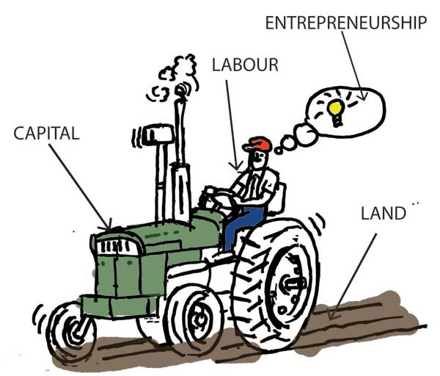
FACTORS OF PRODUCTION
Munif Ahmad

Slide 2
Production

Slide 3
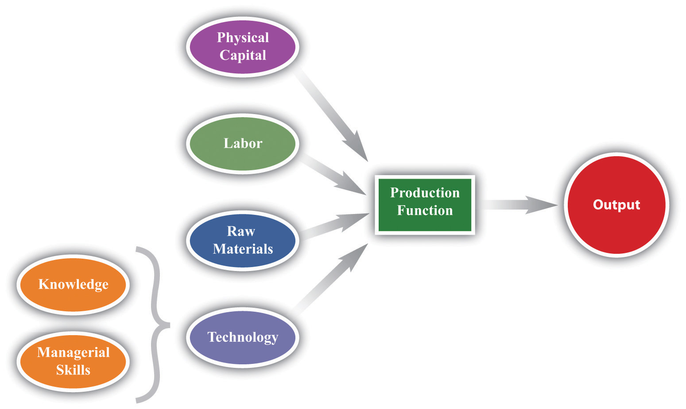
Production function

Slide 4
What are factors of production
In order to produce goods and services to satisfy the needs and wants of consumers need four basic things which are called factors of production.

Slide 5
Factor of production
Meaning-
Basic factors of production
land
labour
capital
entrepreneurship

Slide 6
LAND
“The materials and the forces which nature gives free for man’s aid, in land and water and in air, light and heat”

Slide 7
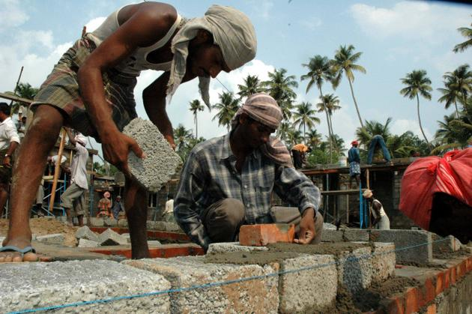
Labour
In economics labour is defined as – “ economic activity of men with HEAD and HAND”.
S0 – “ any exertion of mind or body undergone partly or wholly with a view to some goods other than the pleasure derived directly from the work is called labour”.

Slide 8
Capital
Capital is that part of wealth which is used for production
“Capital consists of all kinds of wealth, other than free gifts of nature, which yield income.” Therefore, every type of wealth other than land which helps in further production of income is called capital

Slide 9
Entrepreneurship
Entrepreneurship is the process in which the entrepreneur scans the environment, grabs the business opportunity, allocates various resources and raw materials that includes land, labour, capital and undertakes the production process.

