Slide 2
SBM Assignment 3
GROUP NAME: DE’LUXURY
10th June 2015

Slide 3
INTRODUCTION
Business Name
De’Luxury
Deluxe
Luxury
Definition for De’Luxury: Rich or something luxurious and with high quality.
Reason why we chose this name as our business name: we obtain high profits as we sell affordable, high quality products.

Slide 4
Our Logo

Slide 5
Vision, Mission, Objectives & Slogan
Vision
“Close to heart for every fashion hunger”
Mission
“To provide competent and efficient services and convenience for customers”
“Expand the business”
“Maintain low cost”
“Create word-of-mouth advertising”
“Ensure customer’s loyalty”
Objectives
Slogan
“What makes you beautiful”

Slide 6
Executive Summary
De’Luxury is our business’s name. It was formed on 20th January, 2015. We will start operating our business on 12th until 15th of March, 2015 at the Oil and Gas Discovery Centre, Seria.
We decided to sell products that are related to fashions as we know that most of the buyers are female buyers and they love to go shopping or buying stuffs. Most of the stuffs that females loved to buy are fashionable products. Therefore, we will be supplying products that are popular nowadays from various suppliers to be sold to our customers. Products such as garments, shawls, cosmetics, accessories, clothes and many more can be found at our business.
Our business consists of six members (5 females and 1 male) where we have a leader, three promoters, an accountant and an assistant accountant. All of us are given different roles, tasks and responsibilities depending on our abilities and strengths. Dayang Noorhazlina as the leader, Iqlyma, Rafika and Naim as the promoters, Lin Zhe as the accountant and Vanessa as the assistant accountant. All of us contribute equal amounts of capital and share equal amounts of profits.

Slide 7
Almost all of our products are female products. Therefore, our target customers are female customers. We had planned on some marketing strategies to attract our customers and some of the strategies are:
Provide low and affordable prices for the products.
Produce lots of flyers and advertisements and distribute them around Seria and Kuala Belait areas.
Promoters will walk around and promote our products to the customers on the days we operate our business.
Selling products that are different from all the others businesses that operate during the 4 days carnival.
Since our business is still new, we hope that the public will be able to accept and choose De’Luxury as their only main sources to get their products in the future. We hope that we will be able to meet the public’s wants and provide them with the suitable products.

Slide 8
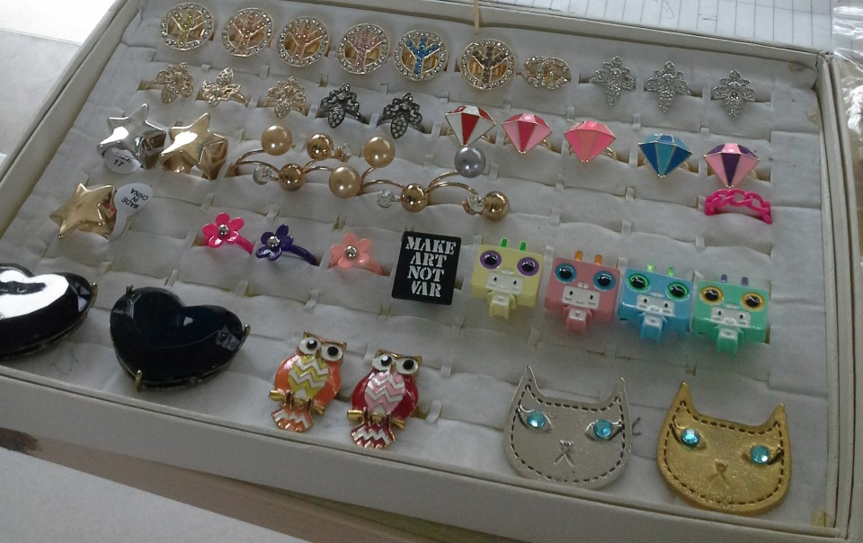
Description and details of the business
For our business, we will be selling non-food products. Most of our products are products that we supply from our suppliers. We supply trendy, fashionable products such as shawls, clothes, cosmetics, accessories and many more.
Accessories
These are the rings that we supply from Janice Closet in Kuala Belait. They are all in varieties kind of colours and designs. The prices of every type of rings are of the range of $1 to $5 each.

Slide 9
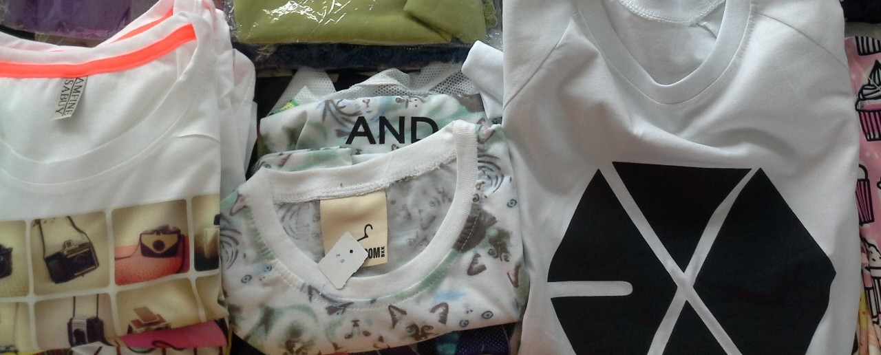
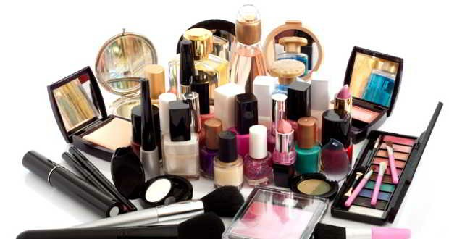
Clothes
These are some of the clothes that we supply from Janice Closet in Kuala Belait. All the clothes are in good quality and all the designs are of trendy designs nowadays. It is because of that that the prices are quite high for every clothes. The prices of each clothes are of the range of $21 to $26.
Cosmetics
These are some cosmetic products that we are going to sell for our business. Since our target customers are mostly female customers, we couldn’t miss out cosmetics! We know most females love to use cosmetic products and they love to make themselves to look as pretty as possible.

Slide 10
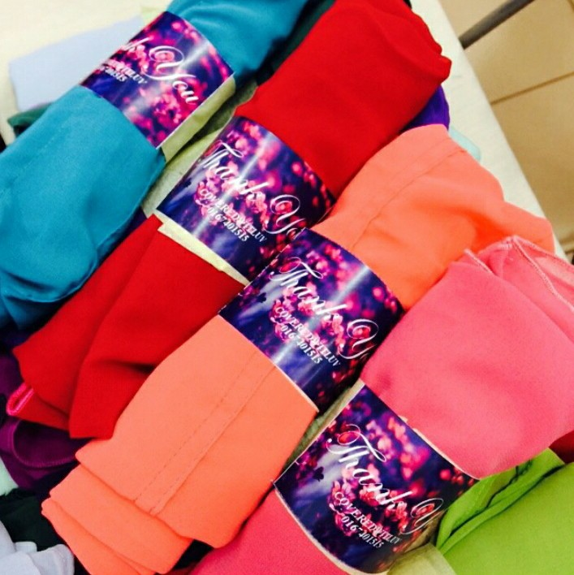
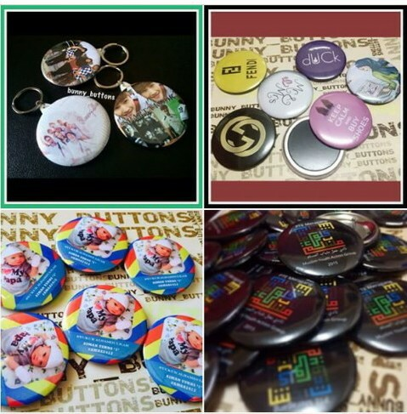
Shawls
These are the pictures of some of the shawls that we supply from our supplier. Shawls are one of the fashionable products that are famous in Brunei Darussalam nowadays. Most females love to wear shawls as what most people think is that wearing shawl is prettier than wearing a normal tudung.
Badges, Magnets & Key chains
These are the pictures of badges, magnets and key chains that we supply from our supplier in Bandar but there’s a pickup venue for us in Kuala Belait. All the badges, key chains and magnets are in varieties designs and colours.

Slide 11
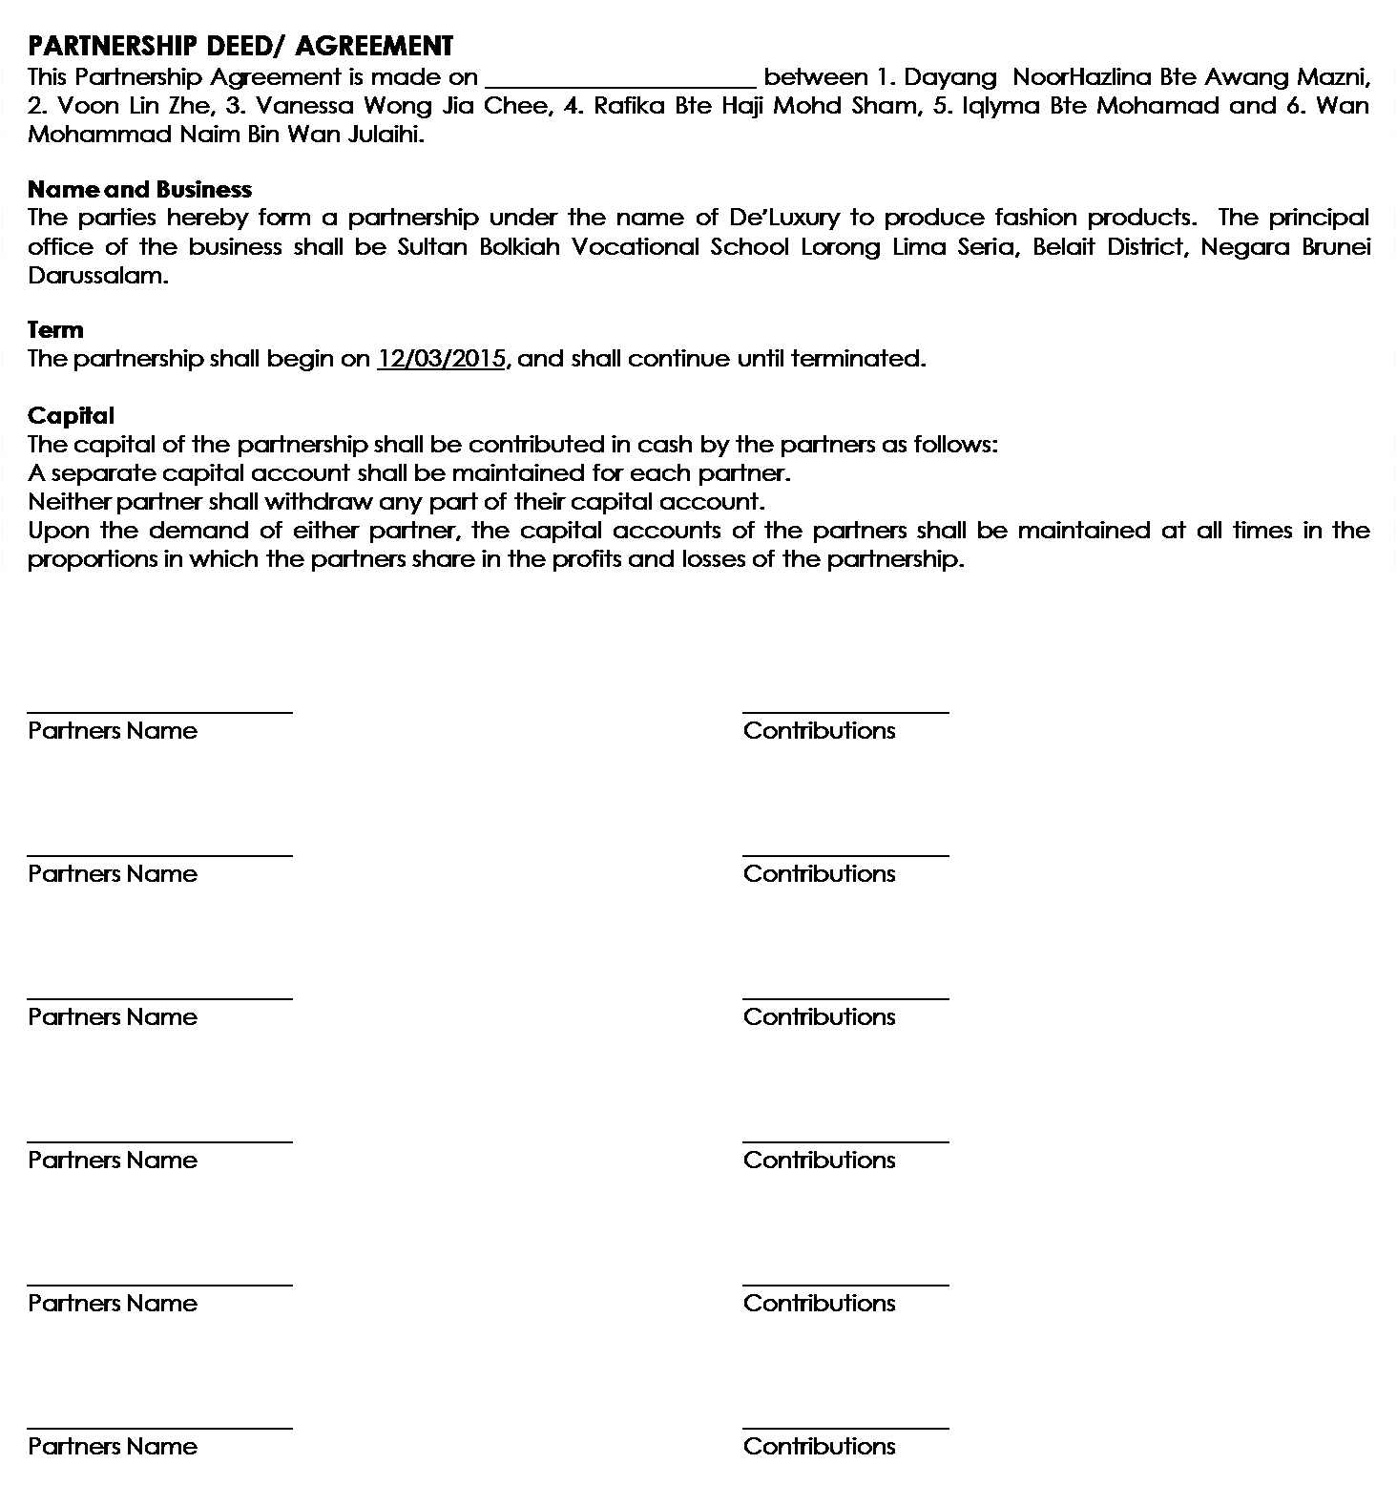
Deed of Partnership

Slide 12
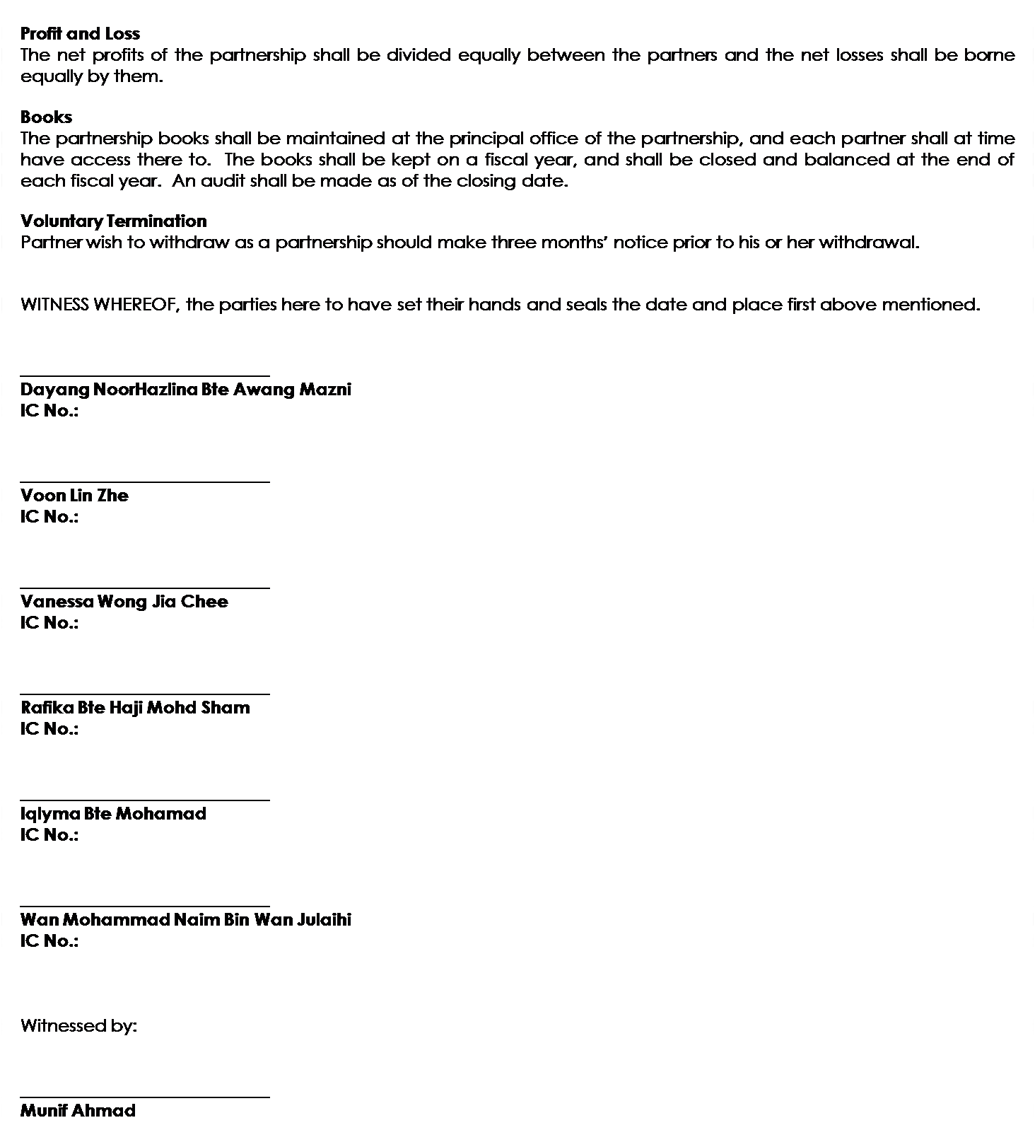

Slide 13
Management Team
Manager
Dayang Noorhazlina
FINANCIAL
Accountant
Lin Zhe
MARKETING
Promoter
Rafika
Assistant Accountant
Vanessa
Promoter
Iqlyma
Promoter
Naim

Slide 14
Financial information
Receipts:
Capital: $20 x 6 = $120
Sales: $2000
Payments:
Purchases: $400
Rent: $40
Advertising (Banner): $50
General Expenses: $120
= $2120 - $590
= $1530 (cash on hand)
$2120
$590

Slide 15
Trading & Profit & Loss Account
Trading & Profit & Loss Account as at…..
$ $
Sales 2,000
Less cost of goods sold
Purchases 400
1,600
Less expenses
Rent 40
Advertising (Banner) 50
General expenses 120 190
Net Profit 1,410

Slide 16
Balance Sheet
1,530
1,530
Balance Sheet as at….
Current Assets $
Cash 1530
Financed by,
Capital 120
Add Net Profit 1410
1530

Slide 17
Trial Balance
PARTICULARS | DR($) | CR($)
Capital |  | 120
Sales |  | 2,000
Purchases | 400
Cash | 1,530
Rent | 40
Advertising (Banner) | 30
General Expenses | 120
 | 2,120 | 2,120

